Slide 1
New Technologies File System (NTFS)

Slide 2
NTFS
Default file system for Windows 10, 8, 7, Vista, XP, 2000, NT, and Windows Servers
No published spec from Microsoft that describes the on-disk layout
Good sources for NTFS information
  www.ntfs.com

Slide 3
NTFS
NTFS was designed for
  Reliability,
  Security, and
  Scalability.
Scalability is provided by the use of generic data structures that wrap around data structures with specific content.
  This is a scalable design because the internal data structure can change over time as new demands are placed on the file system, and the general wrapper can remain constant.
    e.g. a generic wrapper in which every byte of data in an NTFS file system is allocated to a file

Slide 4
Everything is a File
An NTFS file system does not have a specific layout like other file systems, e.g., FAT.
  The entire file system is considered a data area, and any sector can be allocated to a file.
The only consistent layout is that the first sectors of the volume contain the boot sector and boot code.
Notes:
One of the most important concepts in understanding the design of NTFS is that important data are allocated to files. This includes the basic file system administrative data that are typically hidden by other file systems. In fact, the files that contain the administrative data can be located anywhere in the volume, like a normal file can.

Slide 5
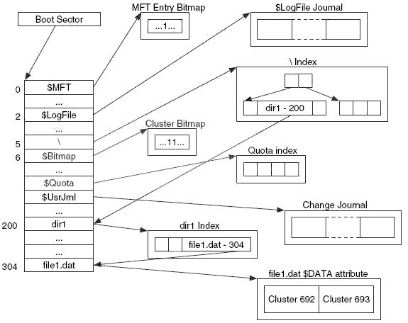
NTFS Example

Slide 6
Master File Table
Contains information about all files and directories
Every file and directory has at least one entry in the table
Each entry is simple
  Size: 1 KB
  Entry header is first 42 bytes
  Remaining bytes store attributes

Slide 7
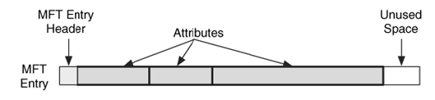
MFT Concepts
The Master File Table (MFT) is the heart of NTFS.
Each entry is 1 KB in size, BUT
  only the first 42 bytes have a defined purpose.
  the remaining bytes store attributes, which are small data structures that have a very specific purpose.
    For example, one attribute is used to store the file's name, and another is used to store the file's content.
    Figure below shows the basic layout of an MFT entry where there is some header information and three attributes.

Slide 8
MFT Properties
Microsoft calls each entry in the table a file record, but calling each entry an MFT entry is simpler.
Each entry is given an address based on its location in the table, starting with 0.
To date, all entries have been 1,024 bytes in size, but the exact size is defined in the boot sector.

Slide 9
MFT Properties: The MFT is a file
The MFT has an entry for itself.
The first entry in the table is named $MFT, and it describes the on-disk location of the MFT.
In fact, it is the only place where the location of the MFT is described; therefore, you need to process it to determine the layout and size of the MFT.
The starting location of the MFT is given in the boot sector, which is always located in the first sector of the file system.
Consider, for example, the case where the MFT is fragmented and goes from clusters 32 to 34 and 56 to 58.
The boot sector is used to find the first MFT entry.

Slide 10
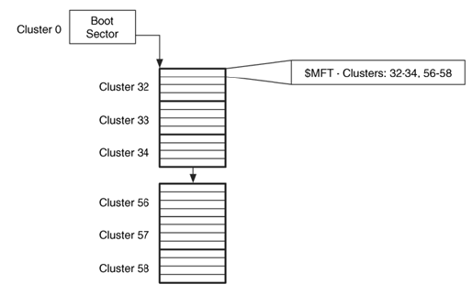

Slide 11
File System Metadata Files
In NTFS file system, every byte in the volume is allocated to a file, therefore, how to find the file system's administrative data or metadata files (according to Microsoft).
  Microsoft documentation says it reserves only the first 16 entries, but in practice the first entry that is allocated to a user file or directory is entry 24. Entries 17 to 23 are sometimes used as overflow when the reserved entries are not enough.
Microsoft reserves the first 16 MFT entries for file system metadata files.
These reserved and unused entries are in an allocated state and have only basic and generic information.
Every file system metadata file is listed in the root directory, although they are typically hidden from most users.
The name of each file system metadata file begins with a "$," and the first letter is capitalized.

Slide 12
The standard NTFS file system metadata files.
Entry | File Name | Description
0 | $MFT | The entry for the MFT itself.
1 | $MFTMirr | Contains a backup of the first entries in the MFT.
2 | $LogFile | Contains the journal that records the metadata transactions.
3 | $Volume | Contains the volume information such as the label, identifier, and version.
4 | $AttrDef | Contains the attribute information, such as the identifier values, name, and sizes.
5 | . | Contains the root directory of the file system.
6 | $Bitmap | Contains the allocation status of each cluster in the file system.
7 | $Boot | Contains the boot sector and boot code for the file system.
8 | $BadClus | Contains the clusters that have bad sectors.
9 | $Secure | Contains information about the security and access control for the files (Windows 2000 and XP version only).
10 | $Upcase | Contains the uppercase version of every Unicode character.
11 | $Extend | A directory that contains files for optional extensions. Microsoft does not typically place the files in this directory into the reserved MFT entries.

Slide 13
$MFTMirr File Overview
As the $MFT file is used to find all other files, therefore, it has the potential of being a single point of failure if the pointer in the boot sector or the $MFT entry is corrupt.
To fix this problem, there exists a backup copy of the important MFT entries that can be used during recovery.
MFT entry 1 is for the $MFTMirr file, which has a non-resident attribute that contains a backup copy of the first MFT entries.
The $DATA attribute of the $MFTMirr file allocates clusters in the middle of the file system and saves copies of at least the first four MFT entries, which are for $MFT, $MFTMirr, $LogFile, and $Volume.

Slide 14
$Boot File Overview
The $Boot file system metadata file is located in MFT entry 7.
It contains the boot sector of the file system.
This is the only file system metadata file that has a static location.
Its $DATA attribute is always located in the first sector of the file system because it is needed to boot the system.
Microsoft typically allocates the first 16 sectors of the file system to $Boot, but only the first half has non-zero data.
The NTFS boot sector is very similar to the FAT boot sector, and they share many fields, e.g., share the 0xAA55 signature.
The boot sector gives you basic size information about the size of each cluster, the number of sectors in the file system, the starting cluster address of the MFT, and the size of each MFT entry.
The boot sector also gives a serial number for the file system.

Slide 15
$Bitmap File Overview
The $Bitmap file system metadata file can be used to determine allocation status of a cluster
It is located in MFT entry 6.
It has a $DATA attribute that has one bit for every cluster in the file system.
For example, bit 0 corresponds to cluster 0, and bit 1 corresponds to cluster 1.
  If the bit is set to 1, the cluster is allocated; if it is set to 0, it is not.

Slide 16
Content Category
  A cluster is a group of consecutive sectors, and the number of sectors per cluster is a power of 2 (i.e., 1, 2, 4, 8, 16).
  Each cluster has an address, starting with 0.
  Cluster 0 starts with the first sector of the file system.
A cluster address can be mapped to a sector address as,
SECTOR = CLUSTER * sectors_per_cluster
An NTFS file is a collection of attributes, some of which are resident (store the content in the MFT entry) and others are non-resident (store the content in clusters).
NTFS does not have strict layout requirements, and any cluster can be allocated to any file or attribute, with the exception of $Boot always allocating the first cluster.

Slide 17
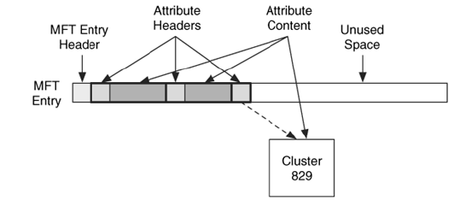
Resident vs Non-resident Attribute

Slide 18
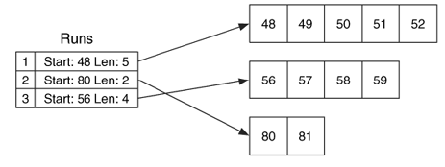
Non-resident Attributes
Non-resident attributes are stored in cluster runs, which are consecutive clusters, and a cluster run is documented using the starting cluster address and the run length.
Example:
  Consider an attribute that has allocated clusters 48, 49, 50, 51, and 52, it has a run that starts in cluster 48 with a length of 5.
  If the attribute also allocated clusters 80 and 81, it has a second run that starts in cluster 80 with a length of 2. A third run could start at cluster 56 and have a length of 4.

Slide 19
Resident vs Non-Resident Attributes
A resident attribute stores its content in the MFT entry
A non-resident attribute stores its content in external clusters
Non resident attributes are stored in cluster runs
The attribute header gives the starting cluster address and its run length

Slide 20
Standard Attribute Types
The standard attributes have a default type value assigned to them, it can also be be redefined in the $AttrDef file system metadata file.
In addition to a number, each attribute type has a name, and it has all capital letters and starts with "$."
Some of the default attribute types and their identifiers are given in the Table next.
Not all these attribute types and identifiers will exist for every file.
Note: Microsoft sorts the attributes in an entry using default type value.

Slide 21
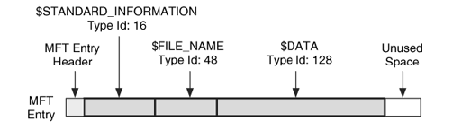
Standard Attribute Type: Example
Consider the following MFT entry with its names and types.
It has the three standard file attributes. In this example, all the attributes are resident.

Slide 22
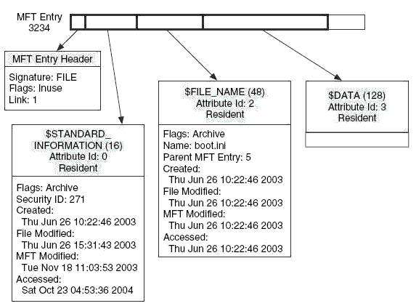
Metadata
All metadata is stored in one of the attributes, so we will now look at details of the file attributes.
To review, a typical file has a $STANDARD_INFORMATION, a $FILE_NAME, and a $DATA attribute.
A typical file that has the standard attributes shown as,

Slide 23
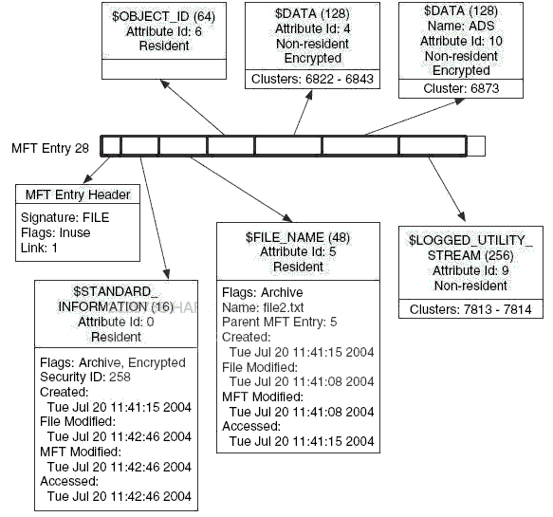
$DATA Attribute

